Slide 1
Exploring Toronto

Slide 2
Problem statement
The question that I am trying to tackle now is to provide a local solution to the residents in toronto to identify similar or different suburbs surrounding them .
With this solution , the residents /new visitor / local council in Toronto could easily locate the difference around every corner of Toronto and could possibly promote every suburb out there.

Slide 3
Data
To obtain data on Toronto’s neighborhood , I will be obtaining data from Toronto's neighborhood . With beautifulsoup library , the data extracted from wikipedia contains the desired content and in the right format, therefore no further data cleaning and arrangement is required with the exception of converting the array of results over to panda’s dataframe format .

Slide 4
Methodology
K-means clustering will be applied onto the data sets where each suburbs will be marked with specific clusters on the map of Toronto.
The neighborhood will be clustered according to the venues that are in them. To obtain extra details regarding the venues , I will be using the EXPLORE endpoint as part of foursquare location API

Slide 5
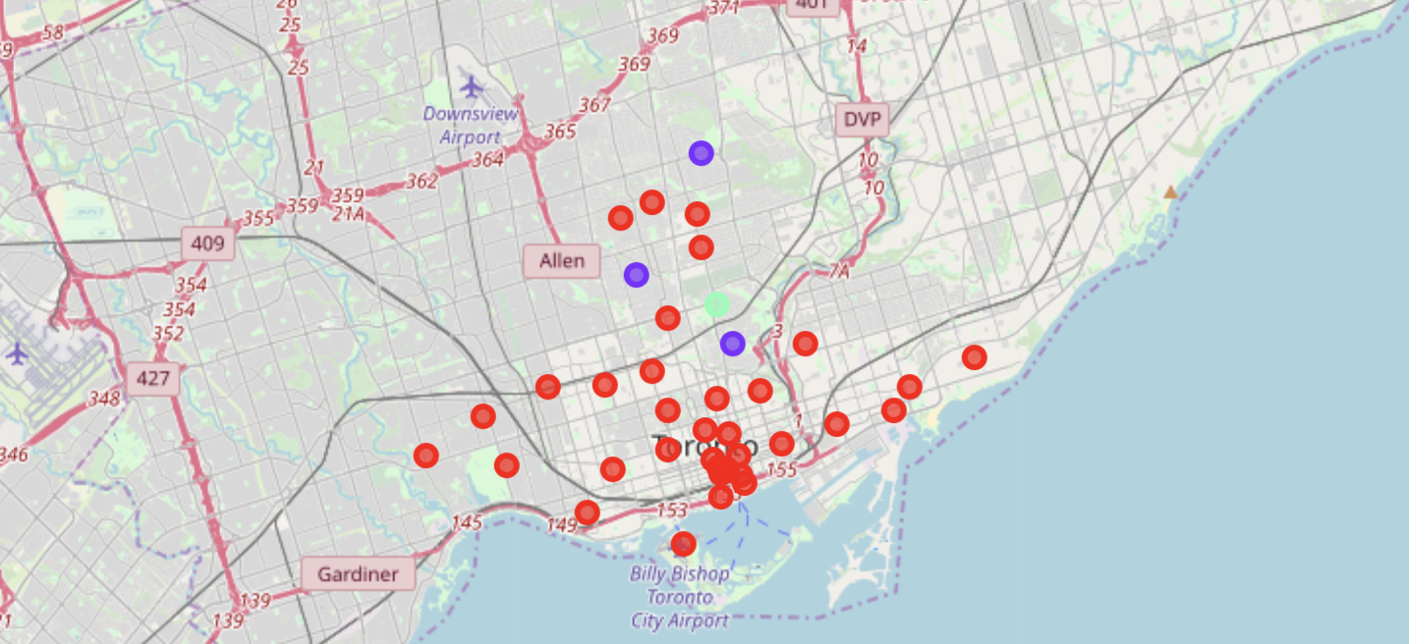
Result ( post clustering )

Slide 6
Result
We can see that most neighborhoods has been labelled with cluster 1 . Where the hotspot are at the center of Toronto .
Getting further away ,you can see members of cluster 2 and 3 appearing , heading up north of the center business district .
Looking at the member breakdown of each clusters in the result section , the number 1 most common venue for cluster 1 is eatery such as restaurants and coffee shop .

Slide 7
Conclusion
With most of Toronto being marked red as the result of k-means clustering , it tells us that Toronto is a city that would be a joy to visit for food lovers . Therefore the local council should promote the hidden gems ( eateries ) in Toronto as the main highlight of the city .
As for the visitors , if you would like to explore the different looks of Toronto , head up north , where you will be greeted with a different demographic .

